Slide 1
Morse Code Decoder
By Karim Elzokm, Arav Tyagi, Parth Prajapati, Ksenia Suglobova
Notes:
Parth

Slide 2
Motivation: Enabling Morse Code for Critical Situations
🚨
⏱️
🚤
Backup Method of Communication
A Morse code translator on board vehicles such as ships or aircraft provides a reliable backup in the form of light or sound communication when modern communication systems fail.
Real-Time Translation
Instantly translates Morse code into readable text, eliminating the need for manual reference or decoding.
Real-World Example
In a storm, if a boat’s primary communication is lost, they are using morse code to call for help, for those who are unfamiliar with Morse code can use our design to decode their message.
Notes:
Parth

Slide 3
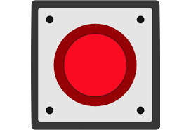
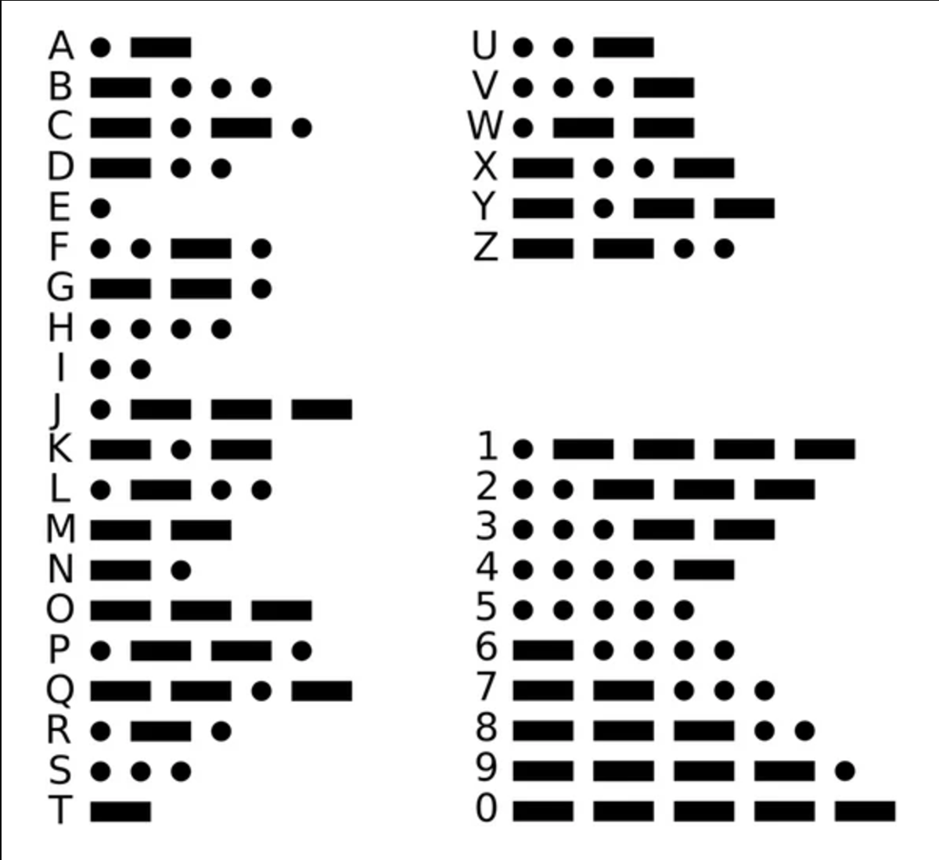
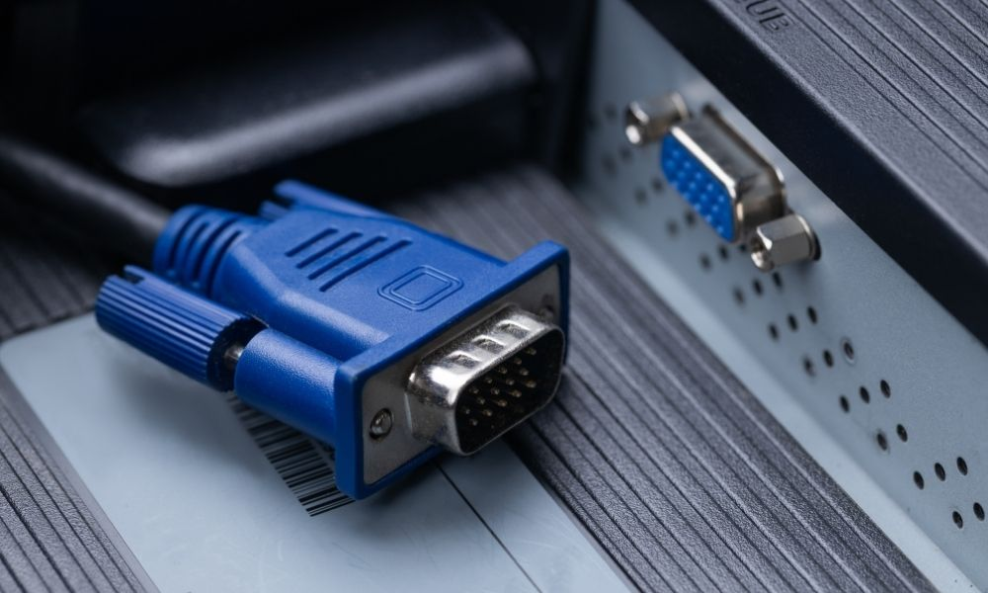

Functionality:
ASCII characters shown on display through VGA
4 Buttons on FPGA
Signals translated into ASCII
Dot
Dash
End of sequence (char_end)
Reset
Notes:
Ksenia

Slide 4
Specifications:
Requirements :
Input Mechanism: One or more buttons to relay more code sequence
Translation: Convert Morse code signals into ASCII letters, numbers, and symbols.
Output Display: Show decoded characters through VGA.
Error Handling: Identify invalid inputs and allow reset functionality.
Performance: Near real-time signal processing and translation.
Constraints :
Display Limitations: Limited characters through VGA display.
Human Input Imprecision: Human error does not allow extremely precise inputs based on time.
FPGA Resources: Optimize design to fit within the board's logic and memory limits.
Notes:
Ksenia

Slide 5
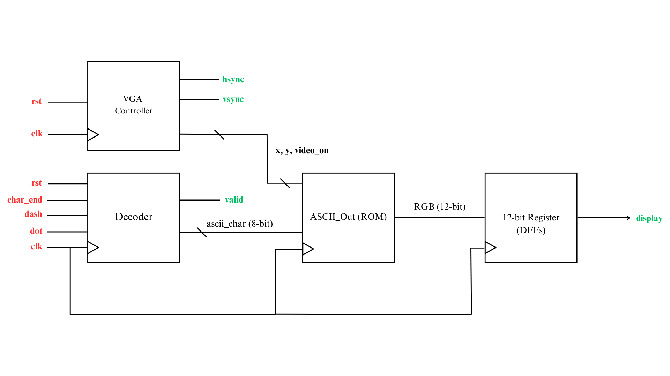
Overall Block Diagram
Notes:
Karim

Slide 6
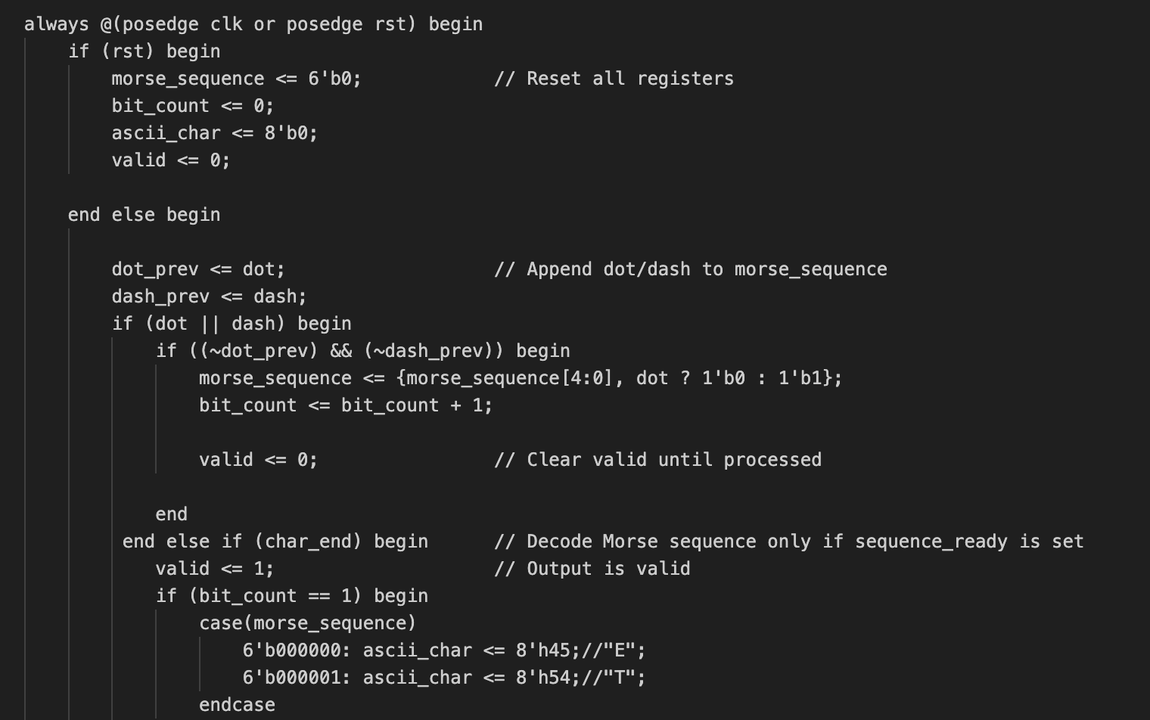
Code Snippet: Recording and Processing Signals
Decoder.v functionality:
When either dot or dash input is high: appends 0 for dot and 1 for dash to morse sequence and adds to bit_count.
Appending happens only if there’s a transition from an idle state (both dot_prev and dash_prev are 0).
Existing bits are shifted left to make room for new ones
Starts decoding based on bit_count only when char_end is pressed.
Notes:
Ksenia

Slide 7
Code Snippet: Recording and Processing Signals
Decoder.v benefits:
Takes care of double counting error at successive clock edges by implementing previous states.
Filters by bit_count allowing for differentiating between different lengths of morse code.
Sets ‘valid’ output to high when char_end is pressed, signaling that there is a decoded output.
Notes:
Karim

Slide 8
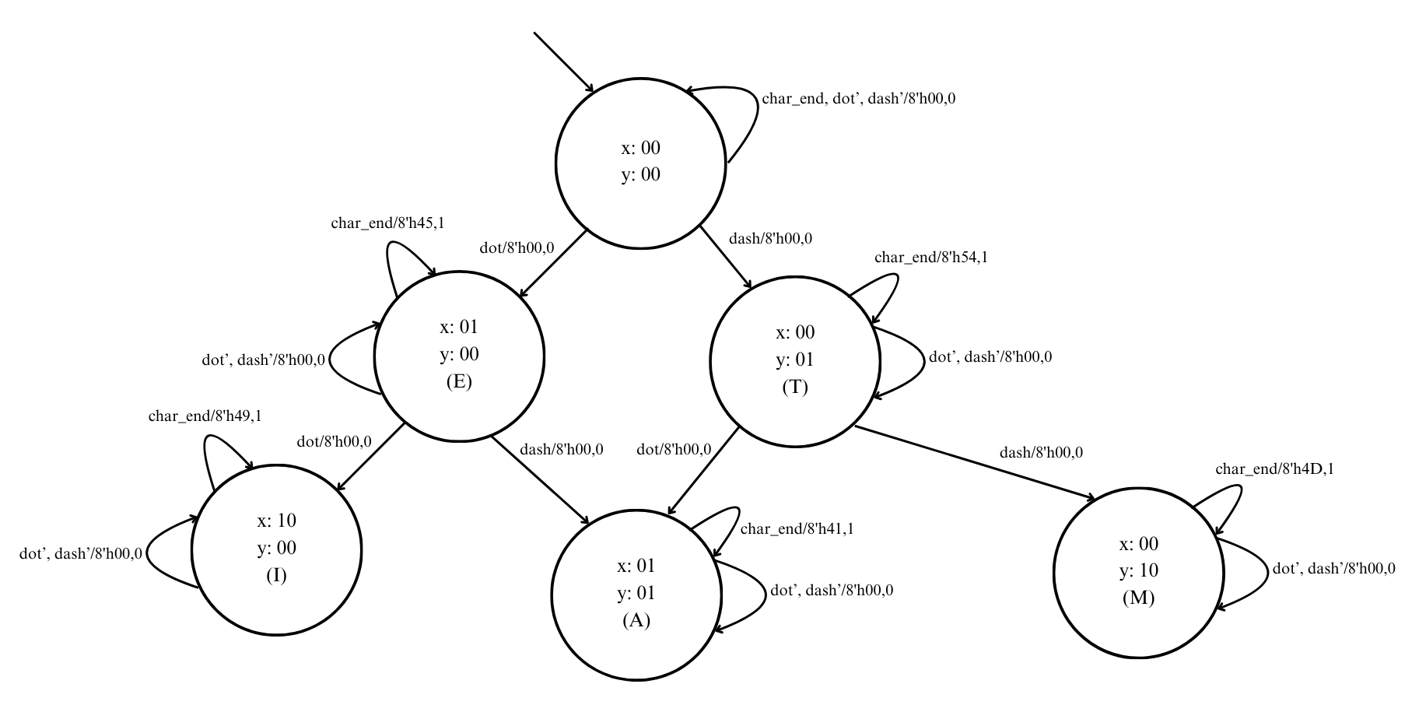
State Diagram
Due to the large number of characters in our module, the state diagram will involved 32+ states, which is too large to fit in one slide. The following is a state diagram showing the basic functionality with a few characters that extends naturally and fully to more characters.
State ‘x’ is for dots and ‘y’ is for dashes, output is ascii_char (8-bit), valid (1-bit).
Notes:
Karim

Slide 9

Successes (As of December 3rd) :
1. Effectively decoding button signals
Detected button presses using a positive edge clock.
Avoided duplicate signal counts by implementing a previous state.
Employed separate buttons for dots and dashes to avoid mistakes due to human error that could form with 1 button.
Implemented a char_end signal to accurately mark the end of a button press sequence, ensuring precise input handling.
2. Displaying ASCII to screen
Through a library of hex to ASCII, the hex code from the decoder is then converted to and ASCII bit matrix and sent to VGA module.
Displays correct letter at the center of the screen in clear text.
Notes:
Parth

Slide 10
Failures:
Implementing 1 Button
Considered implementing a timed button first, but used different buttons for → functionality
Prevents human timing errors, but also has the potential to slow down the usage.
If we had more time, we would implement a timing module to adhere to the morse code standards of dot and dash.
Displaying Multiple Characters at Once
Currently, the VGA module has been working with displaying only one character at a time.
For next steps, we want to be able to display a sequence of characters from right to left through VGA as a more sentence like display.
Notes:
Parth

